Slide 1
Minor Project Automatic Helmet Detection (Review 1)
-16BIT047(Rahul)
-17BIT071(Jay)
Guide: Prof. Vishal Parikh

Slide 2
Title
We are currently working on Automatic helmet detection.
In this project we are going create the programme that can detect whether the person is wearing helmet or not by images.

Slide 3
Dataset
We have created dataset of three different kind of images.
1. Persons
2. Two wheelers
3. Helmet
We have downloaded this images from the different sources. And there are total of 720 images.

Slide 4
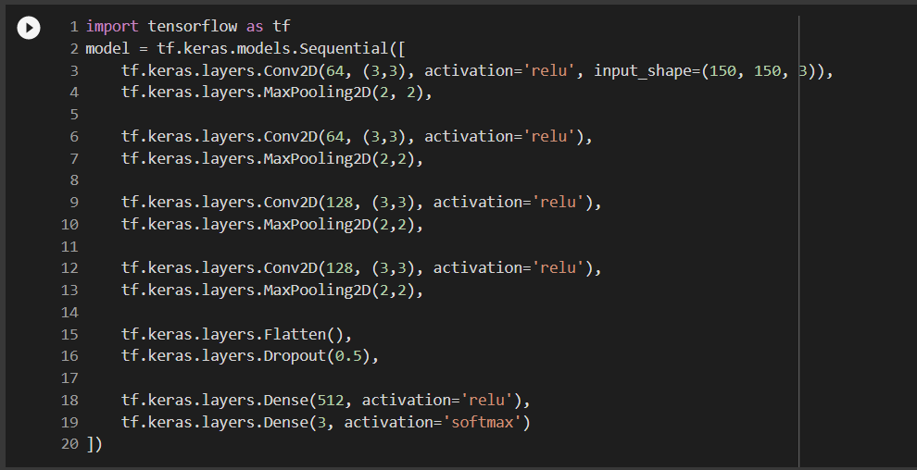
Model
We have created the model using multiple layers of CNN, maxpooling, with the activation function of relu and softmax.

Slide 5
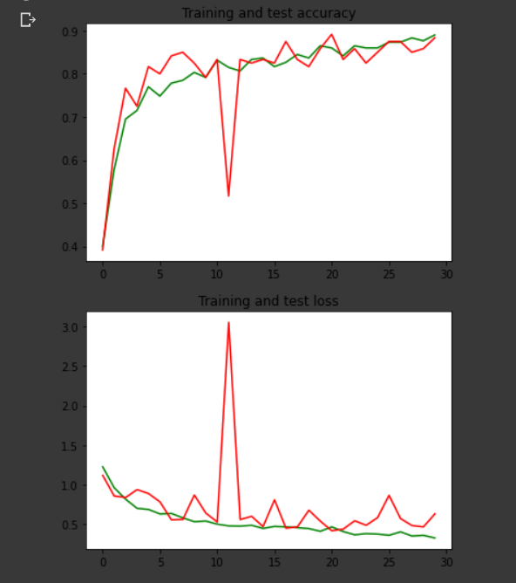
The we have used image augmentation of train dataset to generate more images.
Then we converted size of the images in 150X150 .
Then we pass the images trough this model to check the accuracy of the model.
We have achieve 88% accuracy in this model.

Slide 6
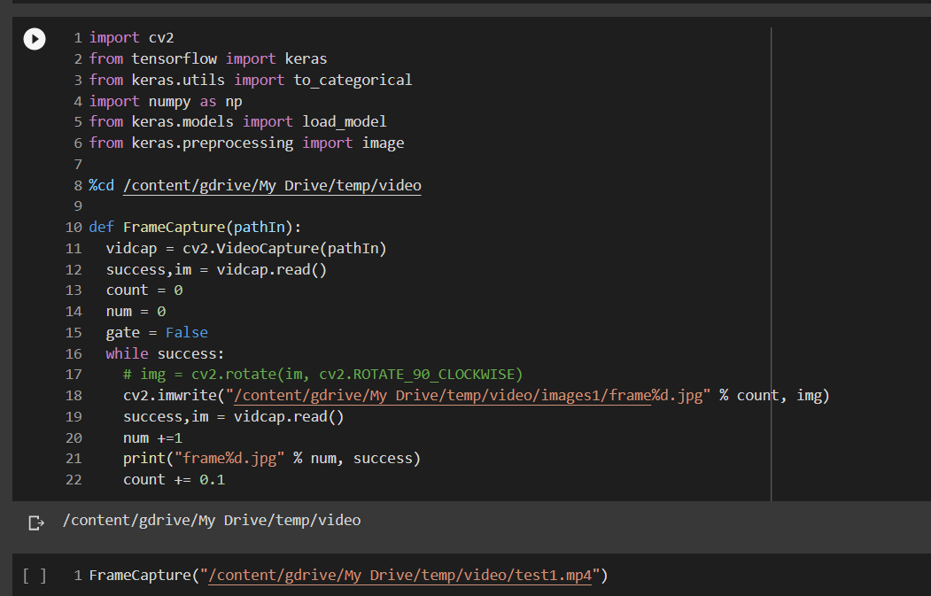
Testing
Then we used OpenCV to extract frames from the videos and pass those images one by one to our model and detect person, two wheeler and helmet.

Slide 7
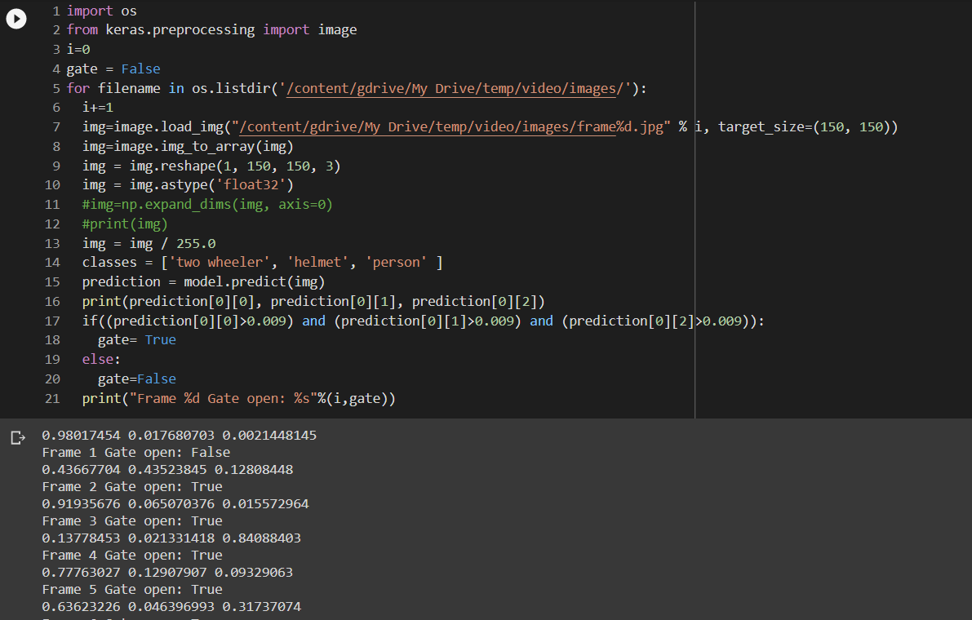
If prediction is above accepted figure then it will set gate variable to true otherwise false.

Slide 8





THANK YOU

